Slide 1
ZAS Academy
Python Curriculum for IOT & AI

Slide 2
Day1 - Agenda
Day 1
Introduction to Raspberry PI
Raspberry PI OS Installation
Connect to Raspberry PI

Slide 3
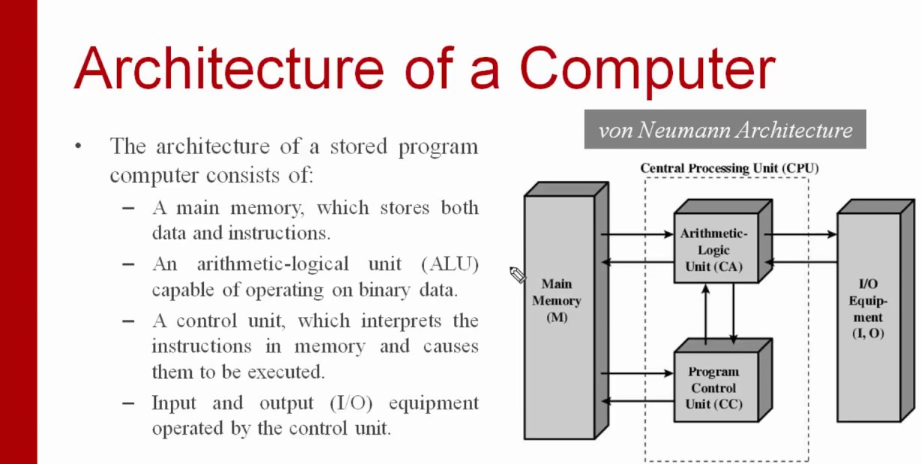
Day1 – Computer Architecture

Slide 4

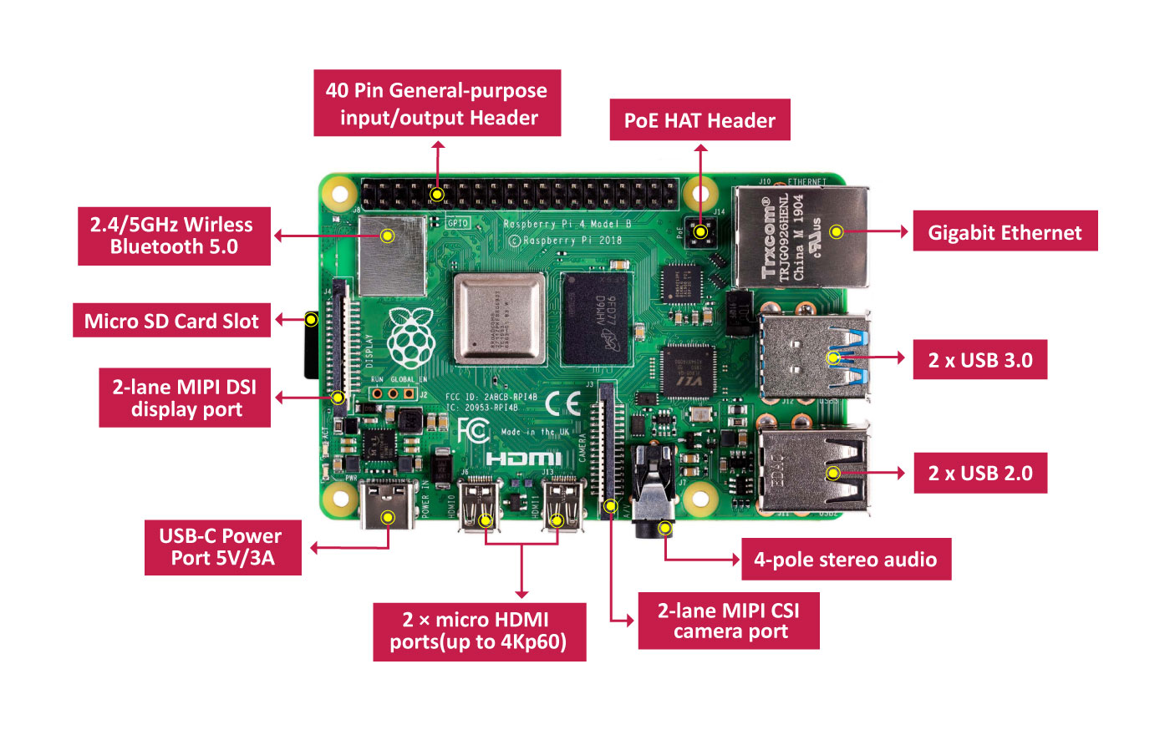
Day1 – Computer Architecture

Slide 5
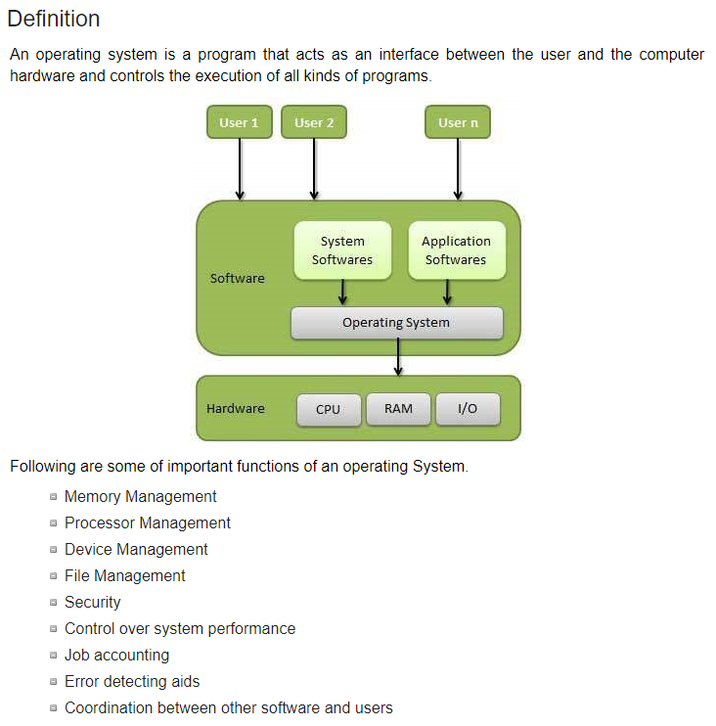
Day1 – Operating System

Slide 6
Day1 – Preparing PI for Action
Step-1: Format the SD Card
Step-2: Burn the OS Image on to the SD Card
Step-3: Create an empty file called “ssh”
Step-4: Insert the SD Card into PI and Bootup
Step-5: Connect to Raspberry PI (via Terminal/Putty)
Step-6: Install VNC Server on PI
Step-7: Enable WIFI, Configure Screen Resolution
Step-8: Connect to PI using VNC Viewer
Step-9: Update/Install Software on Raspberry PI

Slide 7
Day1 – Download Software
SD Card Formatter
Etcher
Raspbian OS Image
FileZilla FTP Client (if you don’t have)
VNC Viewer

Slide 8
Day1 – Required Hardware
SD Card (16/32 GB at least)
SD Card Reader
Raspberry PI 3 – B/B+ or PI4

Slide 9
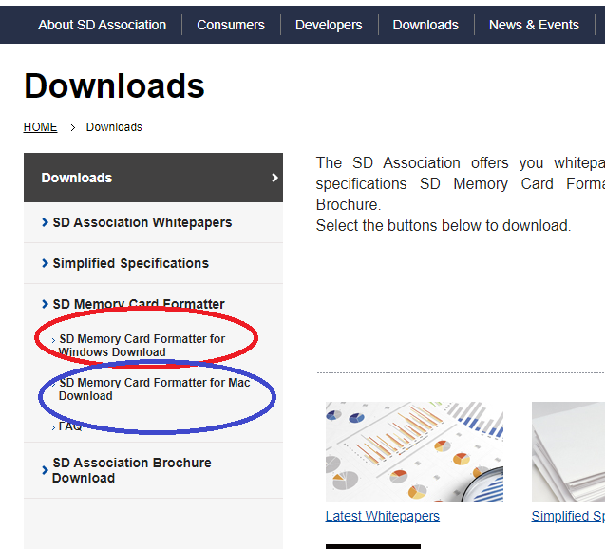
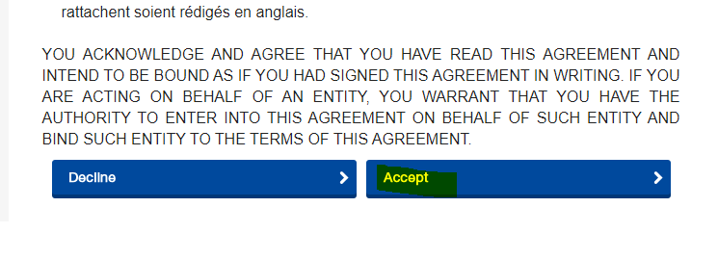
Day1 – Download Software – SD Card Formatter
https://www.sdcard.org/downloads/index.html

Slide 10
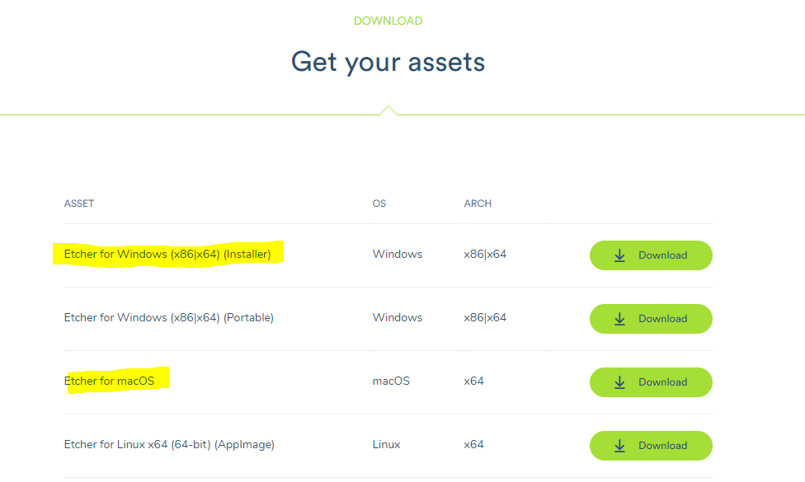
Day1 – Download Etcher
https://www.balena.io/etcher/

Slide 11
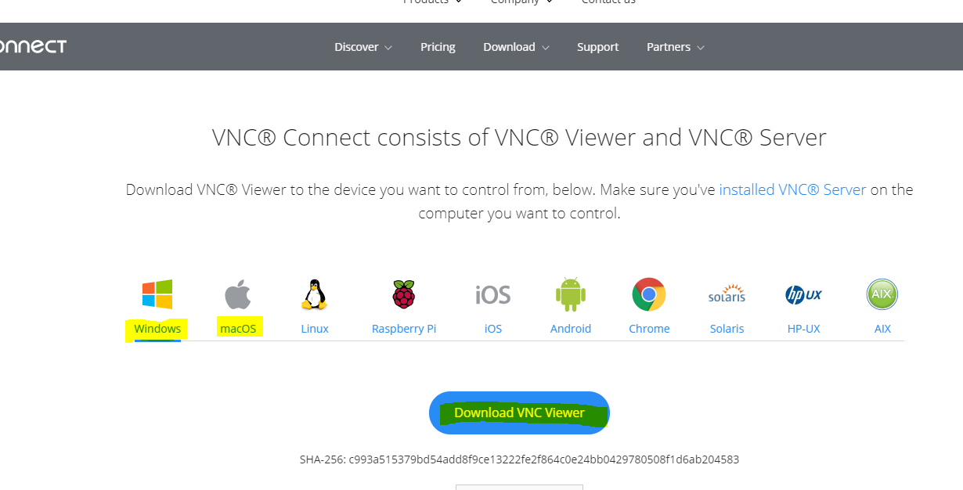
Day1 – Download Software – VNC Client
https://www.realvnc.com/en/connect/download/viewer/raspberrypi/

Slide 12
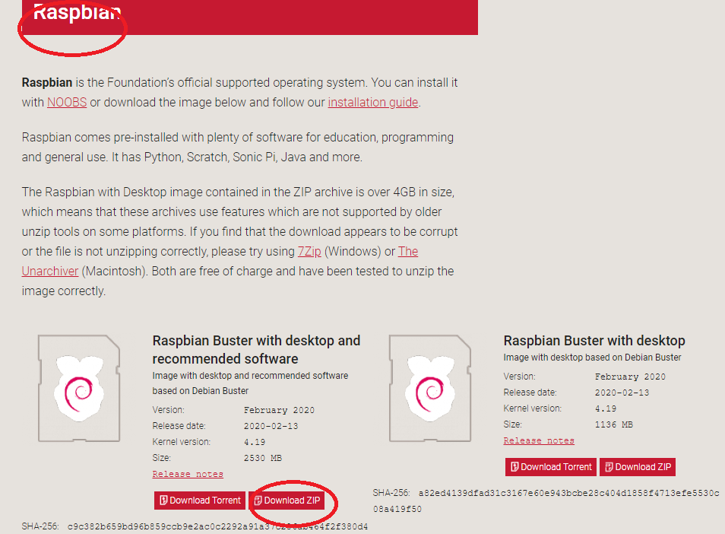
Day1 – Download Software – Raspberry PI Image - Raspbian
https://www.raspberrypi.org/downloads/raspberry-pi-os/
https://www.youtube.com/watch?v=toWBmUsWD6M

Slide 13
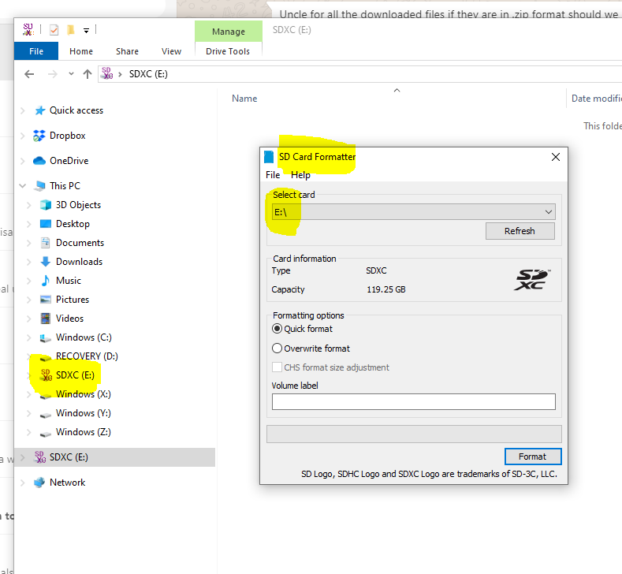
Day1 – Step-1: Format SD Card
Insert SD Card into your laptop
Launch SD Card Formatter app
Select quick format
And click on format

Slide 14
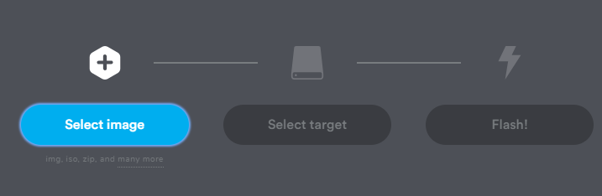
Day1 – Step-2: Copy Raspberry PI Image to SD Card Using Etcher
Launch Balena Etcher App
Select Image
Select SD Card
Click on Flash

Slide 15
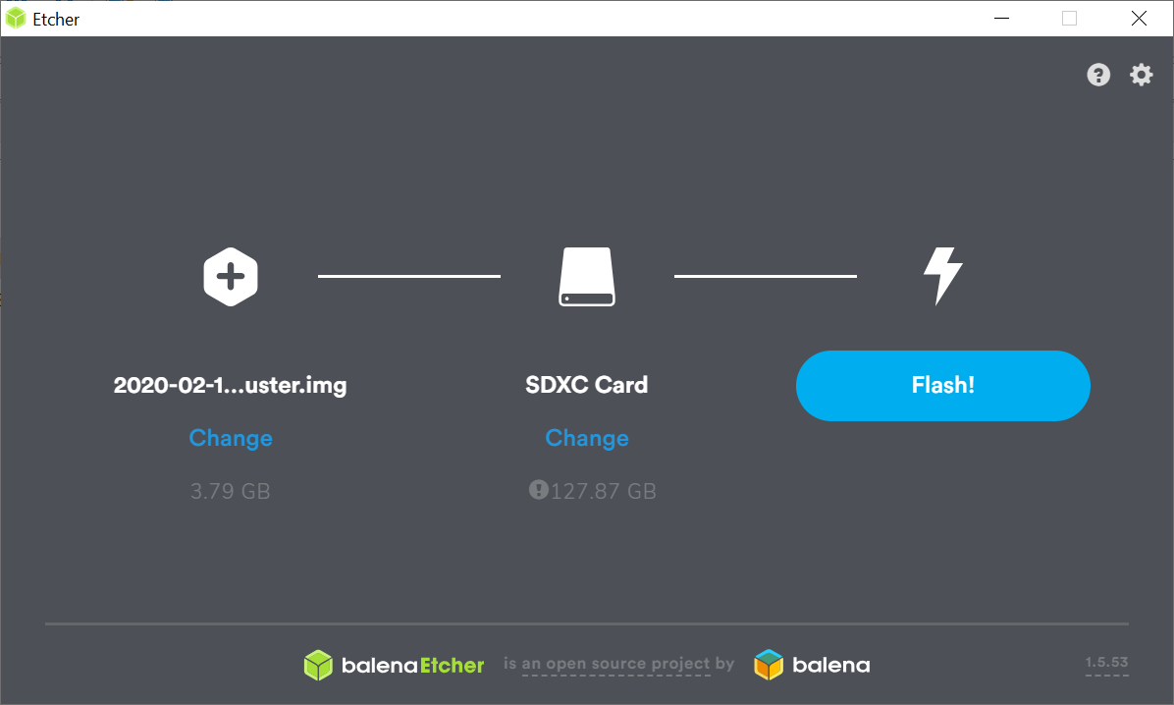
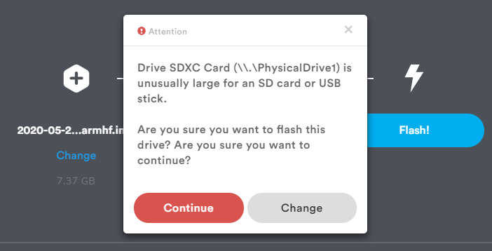
Day1 – Step-2: Copy Raspberry PI Image to SD Card Using Etcher
Launch Balena Etcher App
Select Image
Select SD Card
Click on Flash

Slide 16
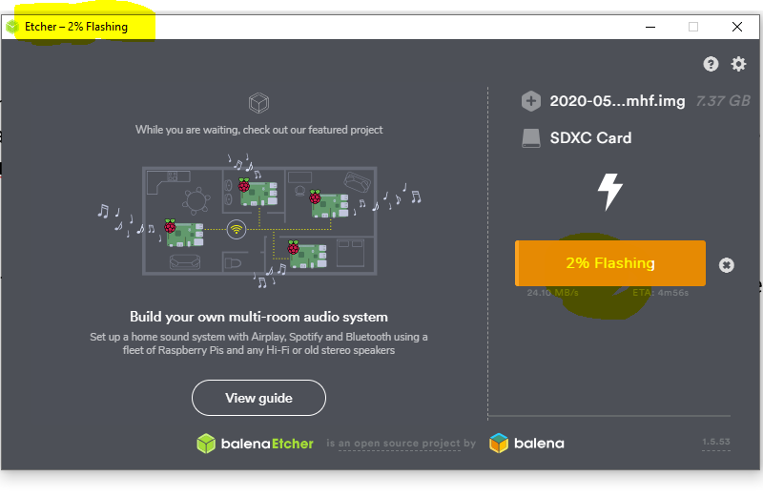
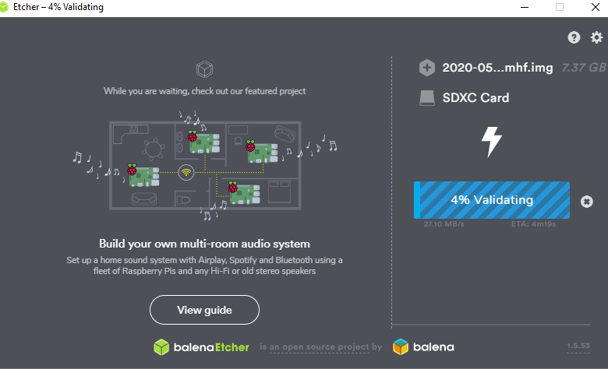
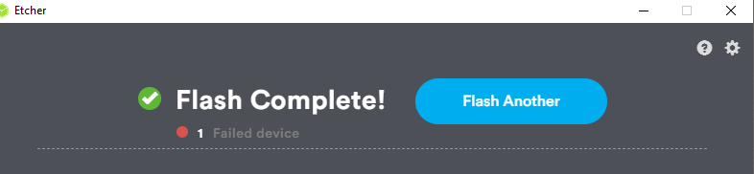
Day1 – Step-2: Copy Raspberry PI Image to SD Card Using Etcher
Launch Balena Etcher App
Select Image
Select SD Card
Click on Flash

Slide 17
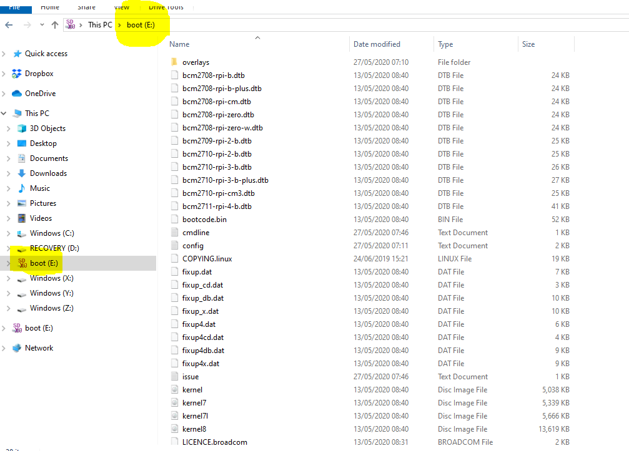
Day1 – Step-3 Create Empty File called: ssh
With SD card still plugged into laptop
Create an empty file called “ssh” and save it on to SD card drive. You can use any of your favourite text editor like – textmate/notepad/text editor etc.
Note: This is required so the SSH server can start automatically when we power on PI

Slide 18
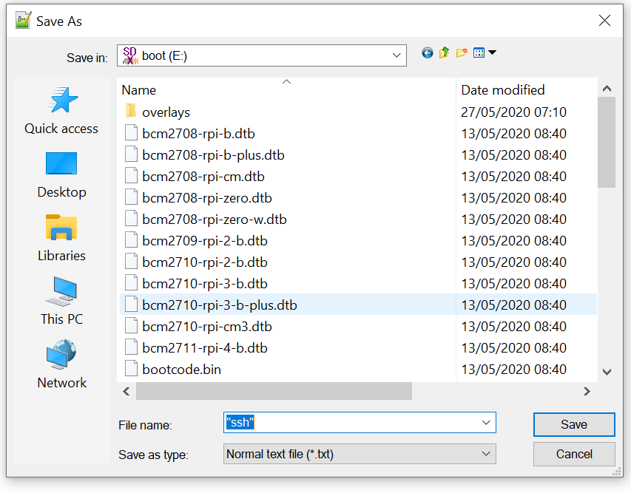
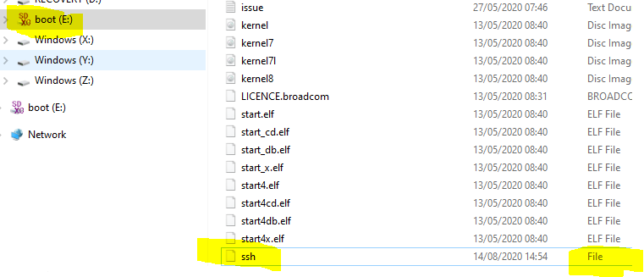
Day1 – Step-3 Create Empty File called: ssh

Slide 19
Day1 – Step-4: Power on PI
Insert SD Card inserted into PI
Power on PI using USB-C cable

Slide 20
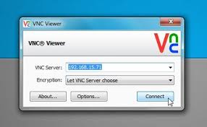
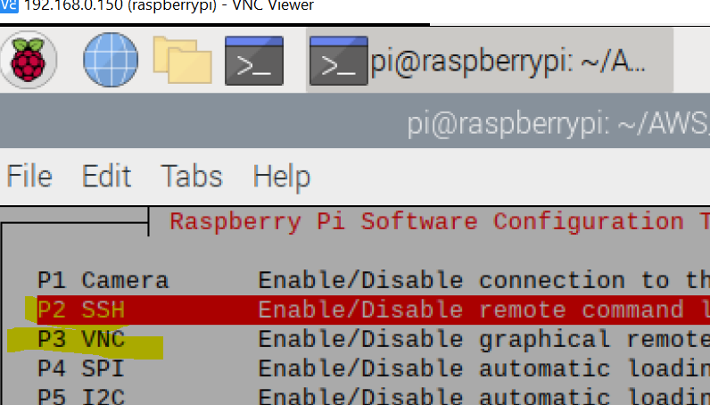
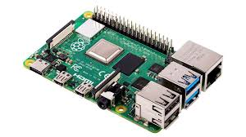
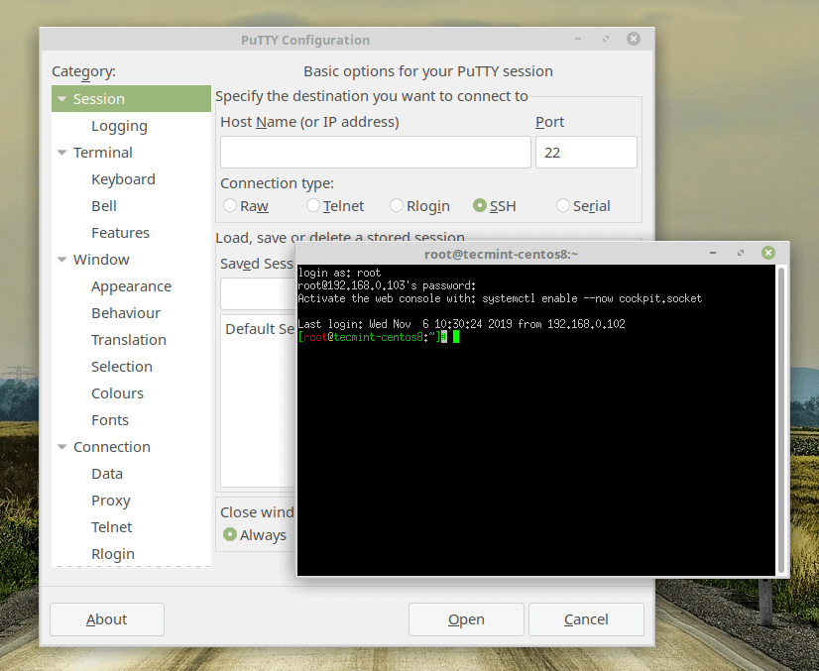
Day1 – Step 5: Options to Connect to Raspberry PI
VNC Viewer Client
To Connect to PI , We need one of them
SSH Server Running
VNC Server Running
But By Default –
SSH Server is not running and disabled (therefore, we need to create an file called “ssh” in the Pi Image SD Card so server starts up automatically).
VNC Server is not installed
SSH Client
(Putty on Windows or
Terminal on Mac)

Slide 21
Day1 – Step:5 Power ON Raspberry PI
Power on Raspberry PI
Insert the SD Card Prepared Earlier into the Raspberry PI
Connect the Network Cable (RJ45) from router to raspberry pi network port
Power on the Raspberry PI

Slide 22
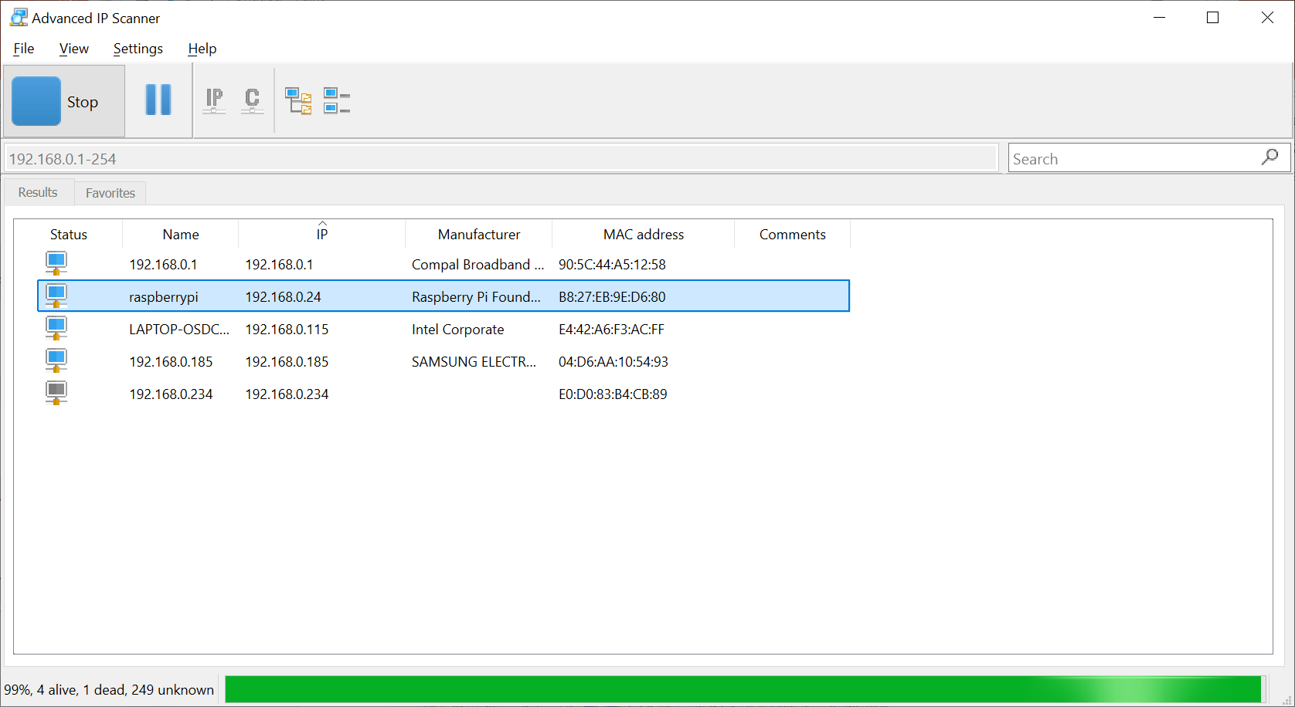
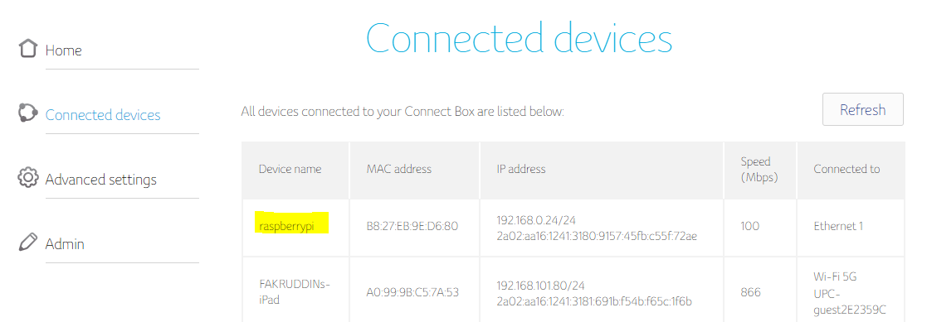
Day1 – Step-5: Finding IP Address of Raspberry PI – 2 Options
Find IP Address of Raspberry PI (via Router)
1. Connect to your router: the connection string might look something like the below:
192.168.0.1
Find IP Address of Using IP Scanner
MAC: https://angryip.org/
Windows: https://www.advanced-ip-scanner.com/

Slide 23
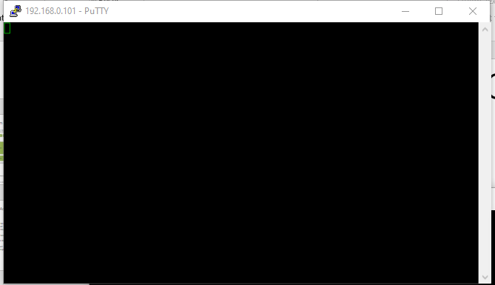
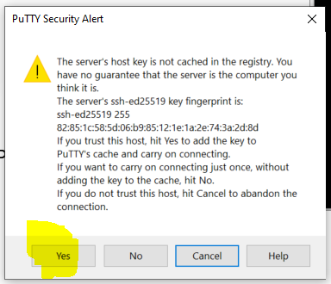
Day1 – Step-5: Connect to Raspberry PI Using Terminal or Putty
ping raspberrypi.local
ssh <ip address>
Raspberry PI Username and Password are below
User Name: pi
Password: raspberry

Slide 24
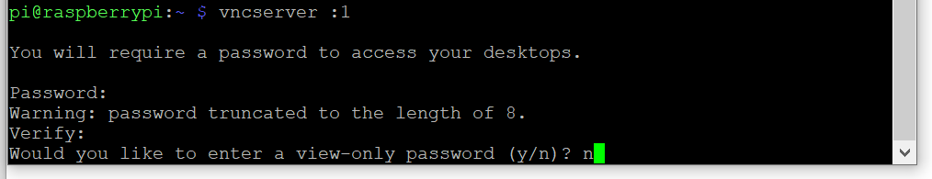
Day1 –Step-6: VNC Server Installation on PI
Run the following commands
sudo apt-get update
sudo apt-get upgrade
sudo apt-get install tightvncserver
Start the vnc server by running the following command
vncserver :1
It will prompt for password set it as: raspberry
For view only password type – n
NOT REQUIRED for PI-4

Slide 25
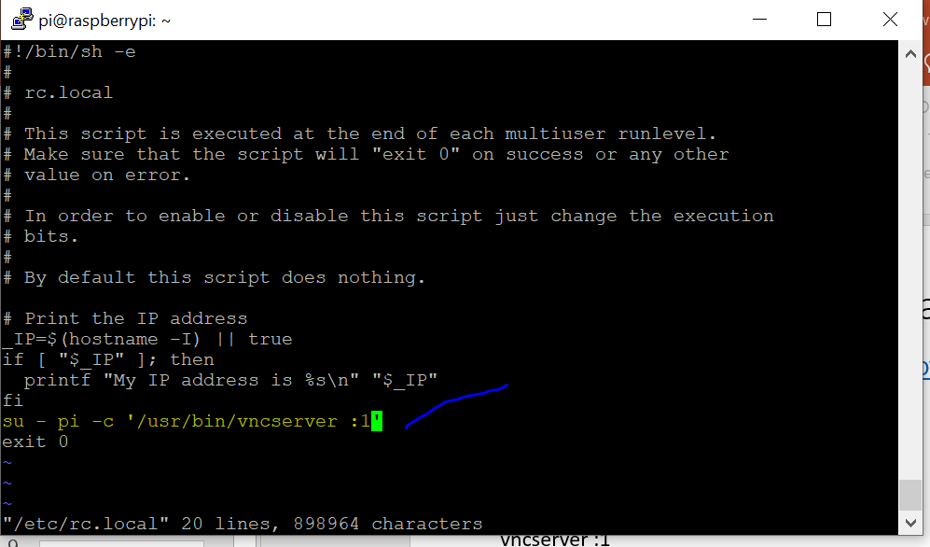
Day1 – Step-6: Configure VNC Server To Start Automatically
https://www.youtube.com/watch?v=JYKZjUgtOYw
1. Using Terminal/Putty login to Raspberry PI device
2. Edit the following file
sudo vi /etc/rc.local
In the file add the following line just before
the last line (screen print below)
sudo – pi –c '/usr/bin/vncserver :1’
3. Save the file
4. Reboot the device by running the following
command
sudo reboot
NOT REQUIRED for PI-4

Slide 26
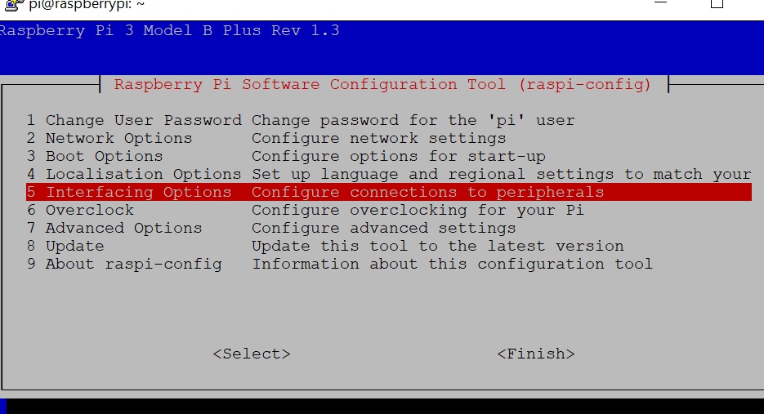
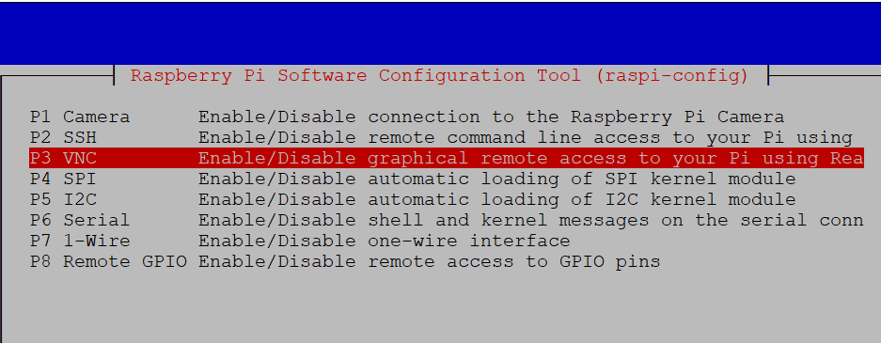
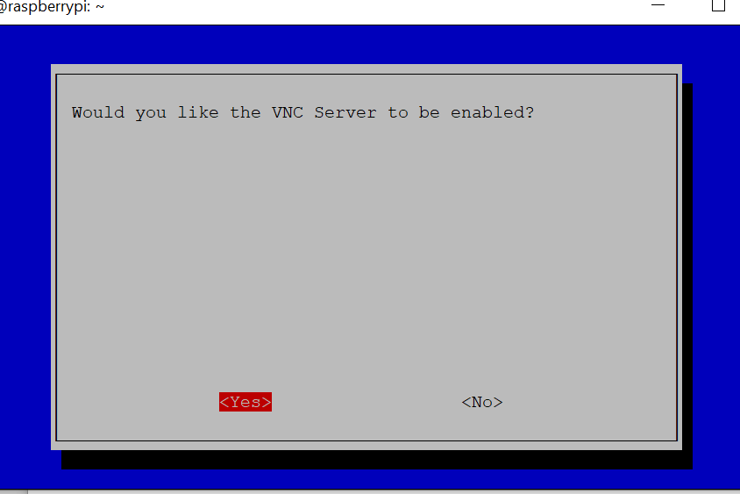
Day1 – Step-7: Enable VNC Server Connections
https://www.youtube.com/watch?v=JYKZjUgtOYw
Run the following commands
sudo raspi-config

Slide 27
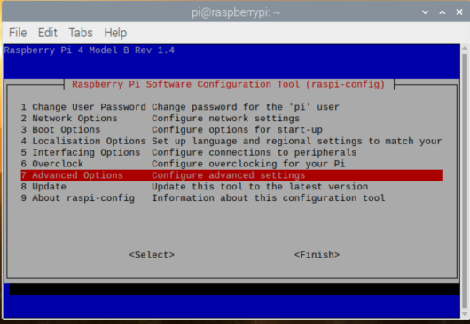
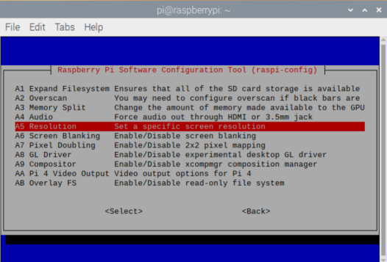
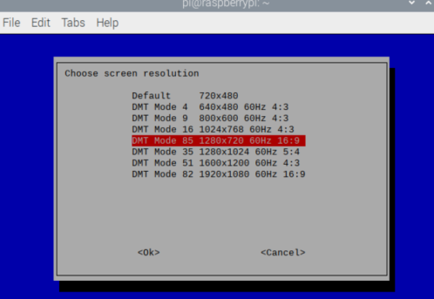
Day1 – Step-7: Change Screen Resolution

Slide 28
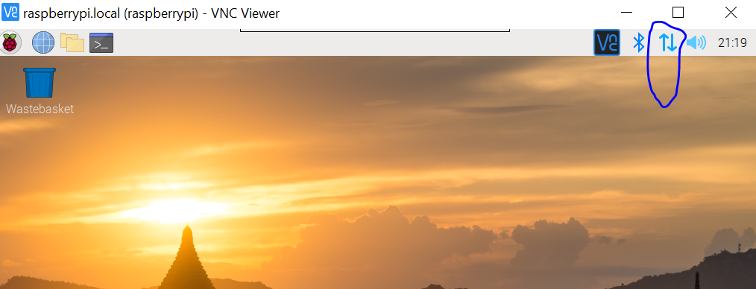
Day1 – Step-7: Enable WiFi
Click on the WiFi Icon
Connect to your WiFi Network (it may prompt for wifi password)

Slide 29
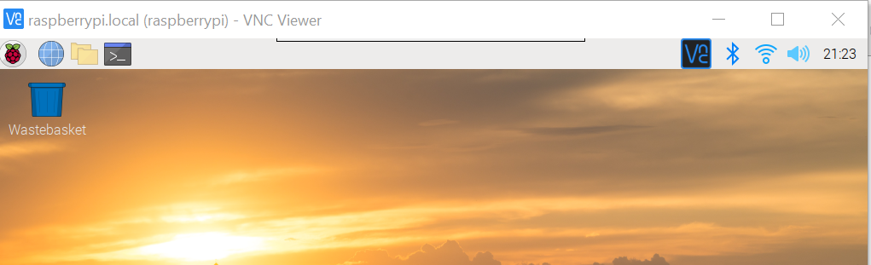
Day1 – Step-7: Enable WiFi

Slide 30
Day1 – Step-8: Power ON Raspberry PI
https://www.youtube.com/watch?v=toWBmUsWD6M
2. Launch the VNC Viewer
3. Create a new connection and connect
4. Raspberry PI Username and Password are below
User Name: pi
Password: raspberry

Slide 31
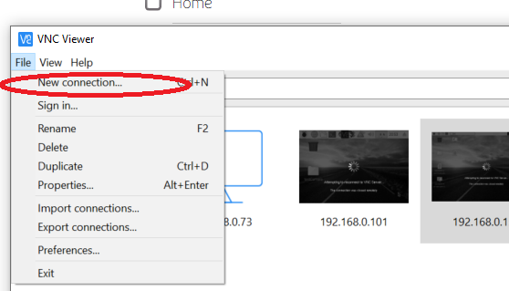
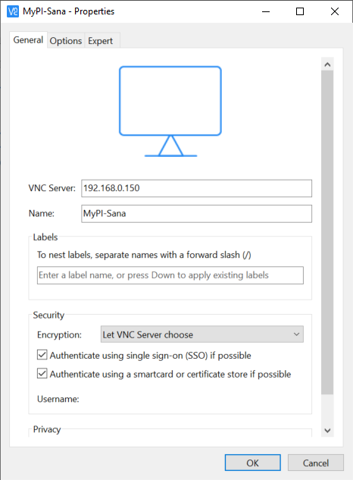
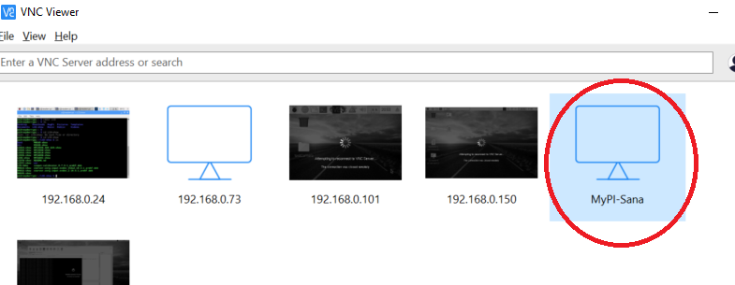
Day1 – Step-8: Download Software – VNC Client

Slide 32
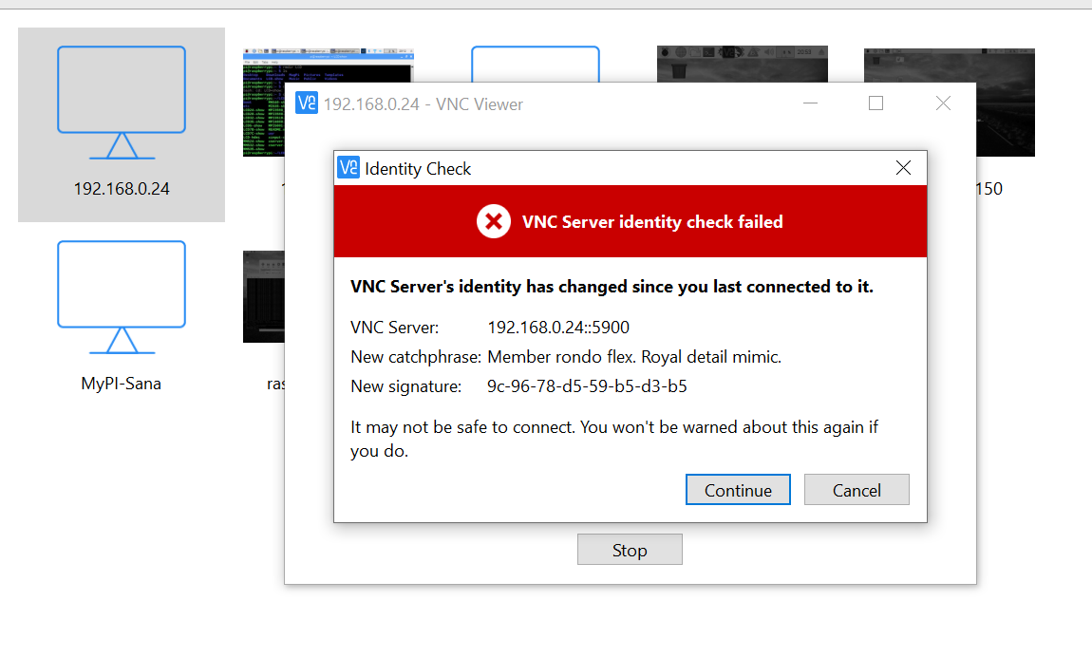
Day1 – Step-8: Connect to Raspberry PI Using VNC Client

Slide 33
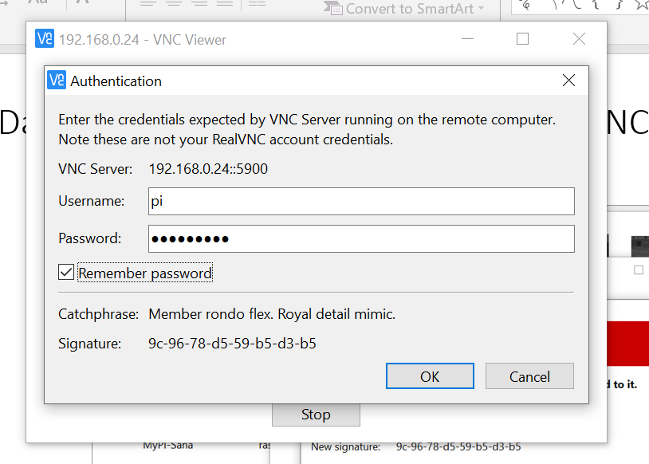
Day1 – Step-8: Connect to Raspberry PI Using VNC Client

Slide 34
Day1 – Step-9: Software Installation on PI
Python3 should have been already installed on Raspberry PI. Please check by running the following command. If not installed follow the instructions at the link - http://www.knight-of-pi.org/installing-python3-6-on-a-raspberry-pi/
python3 --version

Slide 35
Day1 – Step-9: Install Python Libraries for DHT11 Sensor on PI
Connect to PI
Run the following commands to install Python Libraries for DHT11 Sensor.
Reference Link: https://github.com/adafruit/Adafruit_Python_DHT
sudo pip3 install Adafruit_DHT

Slide 36
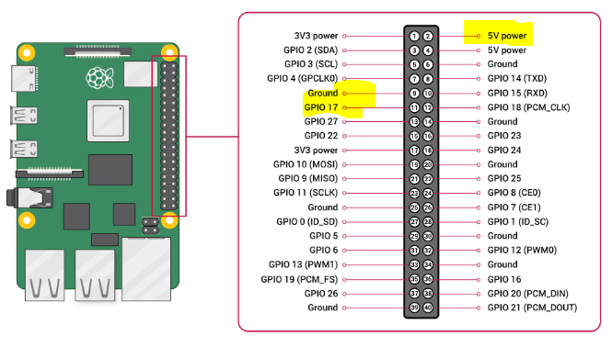
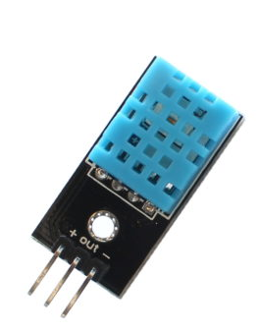
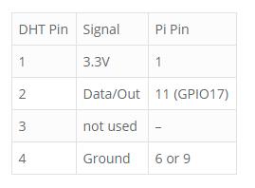
Day1 – DHT11 - Wiring
Please pay attention to PIN Numbers and the corresponding GPIO xx numbers
https://www.raspberrypi-spy.co.uk/2017/09/dht11-temperature-and-humidity-sensor-raspberry-pi/
You Can Use PIN2 which is 5V (as shown in the PIN Diagram)

Slide 37
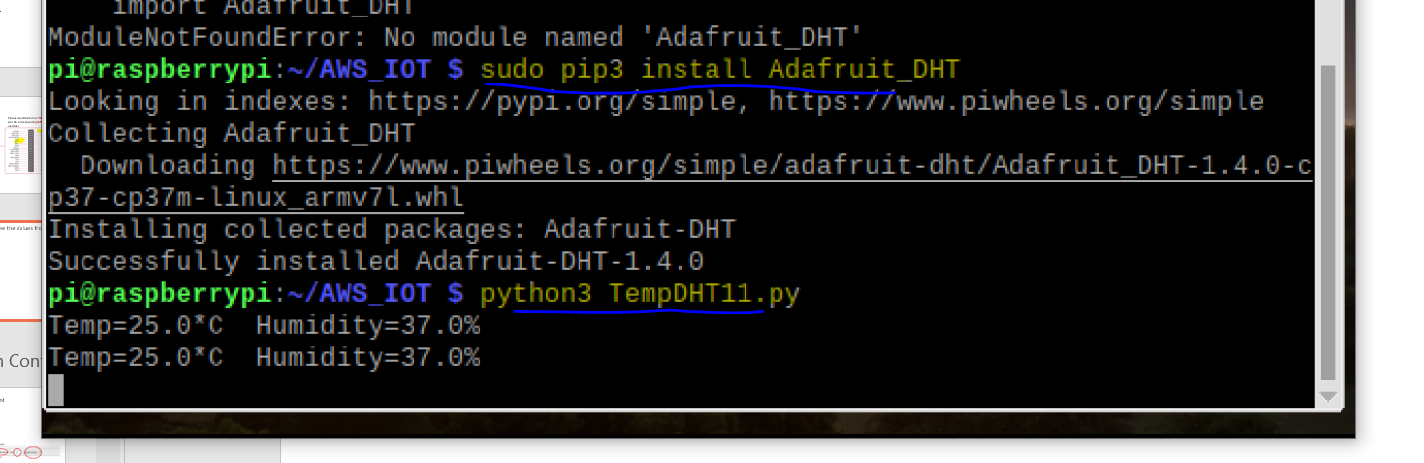
Day1 – Run DHT11 Python Script To See the Values from Sensor
Create a folder called AWS_IOT on PI
mkdir AWS_IOT
Change into the directory AWS_IOT folder
cd AWS_IOT
Copy the TemptDHT11.py script to AWS_IOT folder (you may use FileZilla FTP Client to connect to PI and Transfer the files). Screen print of FileZilla is shown on the next slide
python3 TempDHT11.py

Slide 38
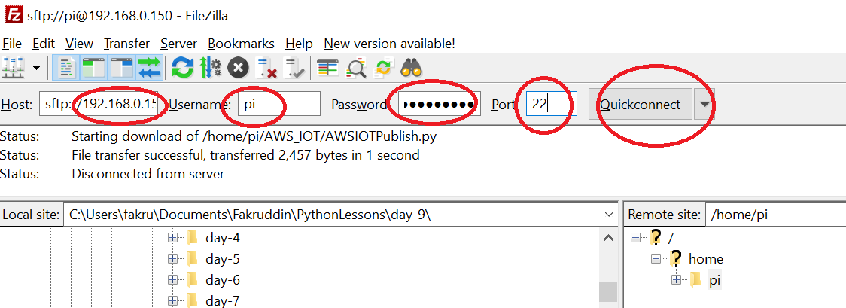
Day1 – Download Software – FTP Client
See the Section FTP Client Installation & Configuration
To Connect to Raspberry PI Board (this step required later)
IP Address of Raspberry PI: 192.168.?.?
User: pi
Password: raspberry
Port: 22

Slide 39
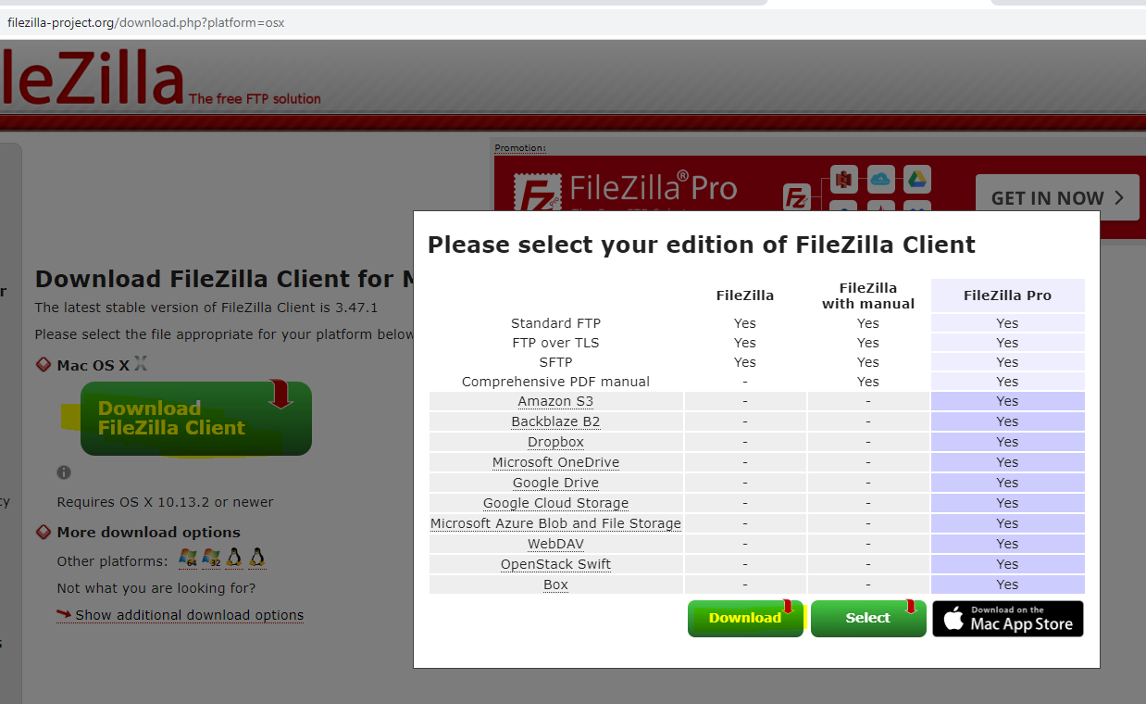
FTP Client Installation
https://filezilla-project.org/download.php?platform=osx

Slide 40
Logistics
Lecture | Date | Day | Time | Comments
1 | 15-Aug-2010 | SAT | 09:00AM
2 | 22-AUG-2020 | SAT | 09:00AM
3 | 29-AUG-2020 | SAT | 09:00AM
4 | 05-Sep-2020 | SAT | 09:00AM
5 | 12-Sep-2020 | SAT | 09:00AM
 | 19-Sep-2020 | SAT | 09:00AM | Midterm Exams
6 | 26-Sep-2020 | SAT | 09:00AM
7 | 03-OCT-2020 | SAT | 09:00AM
8 | 10-OCT-2020 | SAT | 09:00AM
9 | 17-OCT-2020 | SAT | 09:00AM
 | 24-OCT-2020 | SAT | 09:00AM | Dasara Break
 | 31-OCT-2020 | SAT | 09:00AM | Dasara Break
10 | 07-NOV-2020 | SAT | 09:00AM
 | 14-NOV-2020 | SAT | 09:00AM | Diwali Break
11 | 21-NOV-2020 | SAT | 09:00AM
12 | 28-NOV-2020 | SAT | 09:00AM

